Slide 1
בס"ד
Final Project
Tsibulsky David 309444065

Slide 2
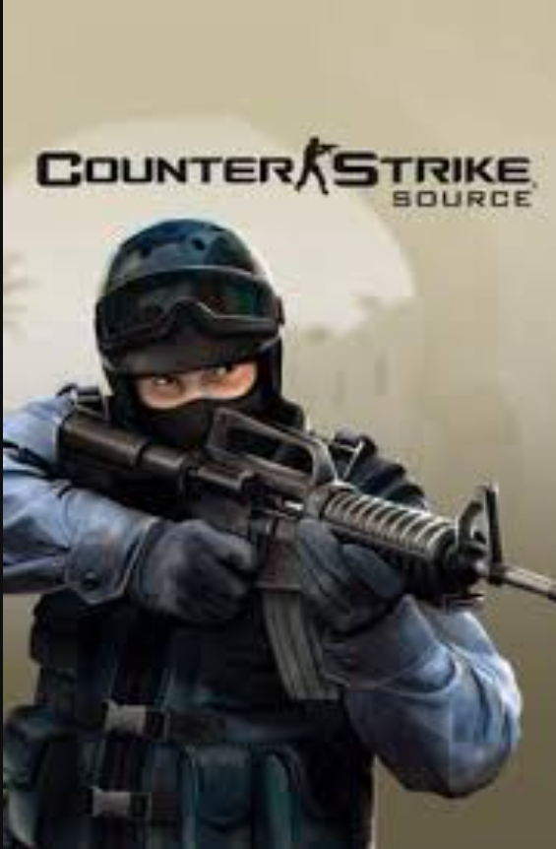
בס"ד
Intro:
I think that I’ve received the most interesting dataset – It’s about the Counter-Strike game - that I realy loved then I was a teenager .
About Counter-Strike:
I think that everyone knows that game , but in case that not – here some description:
Counter-Strike: Global Offensive (CS:GO) is a multiplayer first-person shooter video game developed by Valve and Hidden Path Entertainment. It is the fourth game in the Counter-Strike series and was released for Windows, macOS, Xbox 360, and PlayStation 3 in August 2012, while the Linux version was released in 2014.
The game pits two teams against each other: the Terrorists and the Counter-Terrorists. Both sides are tasked with eliminating the other while also completing separate objectives. The Terrorists, depending on the game mode, must either plant the bomb or defend the hostages, while the Counter-Terrorists must either prevent the bomb from being planted, defuse the

Slide 3
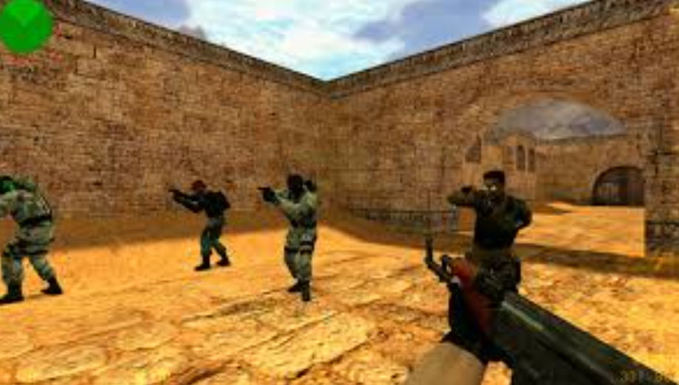
בס"ד
bomb, or rescue the hostages. There are nine game modes, all of which have distinct characteristics specific to that mode. The game also has matchmaking support that allows players to play on dedicated Valve servers, as well as allowing members of the community to host their own servers with custom maps and game modes. A battle-royale game-mode, "Danger Zone", was introduced in December 2018.
About data set :
The data set size is 122410 rows x 29 columns .
Each row represent one game . All games were 5v5, meaning 5 players on each team (terrorists and counter-terrorists).

Slide 4
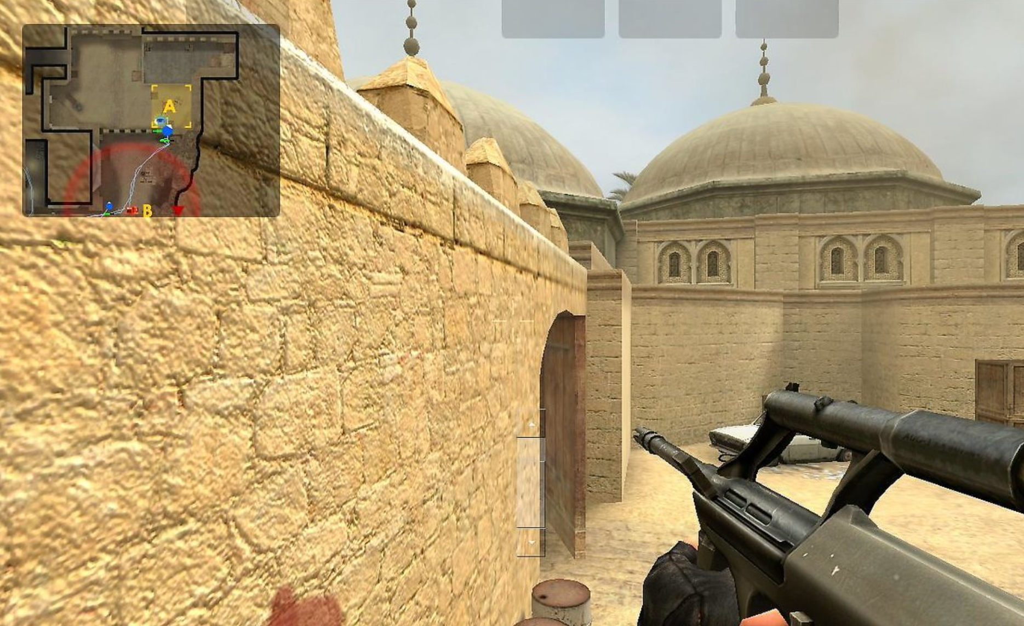
בס"ד
The features are :
General Features:
time_left: continuous, time left until game ends
map: categorical, game map played
bomb_planted: boolean, True/False was the bombed placed by terrorist team
ct_defuse_kits: number of defuse kits on CT team
Per Team Features:
score: continuous, current team score
health: continuous, current team health (out of 500)
armor: continuous, current team armor (out of 500)
money: continuous, current team money

Slide 5
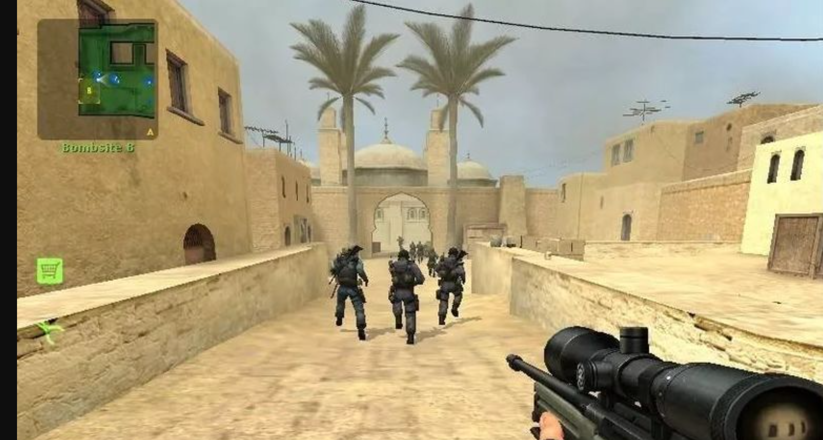
בס"ד
helmets: integer, number of team members with helmets
players_alive: integer, number of team members alive
grenade_hegrenade: integer, number of team members with grenade_hegrenade
grenade_flashbang: integer, number of team members with grenade_flashbang
grenade_smokegrenade: integer, number of team members with grenade_smokegrenade
grenade_incendiarygrenade: integer, number of team mem. with grenade_incendiarygrenade
grenade_molotovgrenade: integer, number of team members with grenade_molotovgrenade
grenade_decoygrenade: integer, number of team members with grenade_decoygrenade:
Target Class:
round_winner: Counter Terrorists / Terrorists
A 't' in the column name prefix indicates the terrorist team features, and
a 'ct' in the column name prefix indicates the counter terrorist team features.

Slide 6
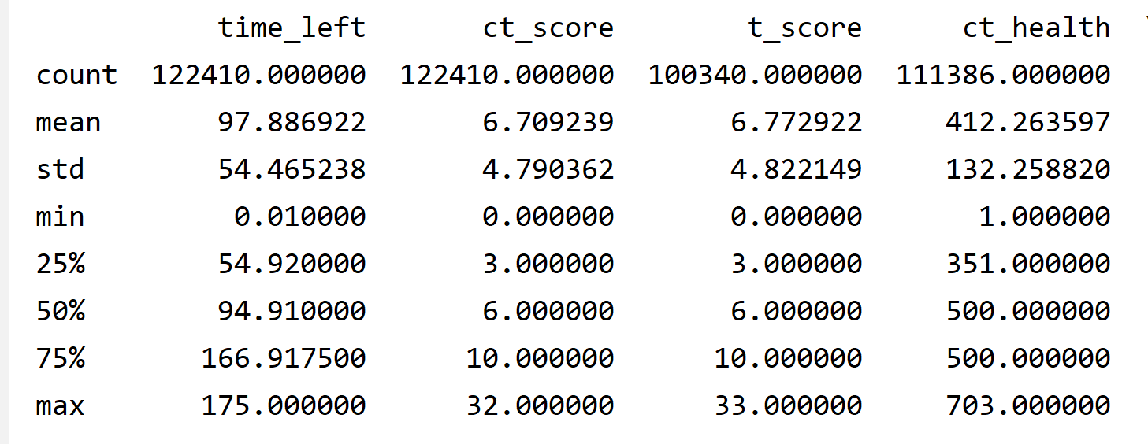
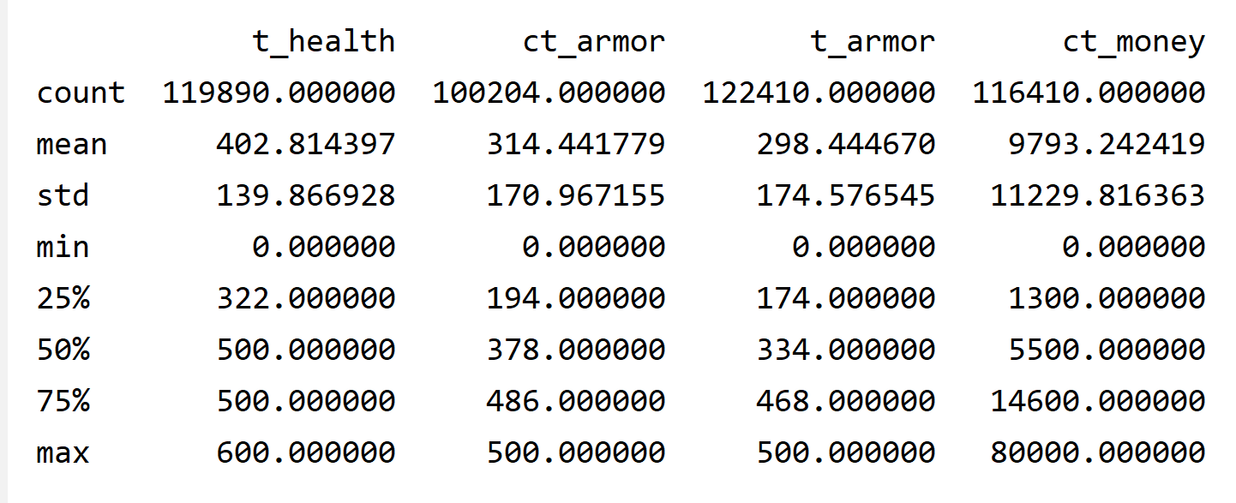
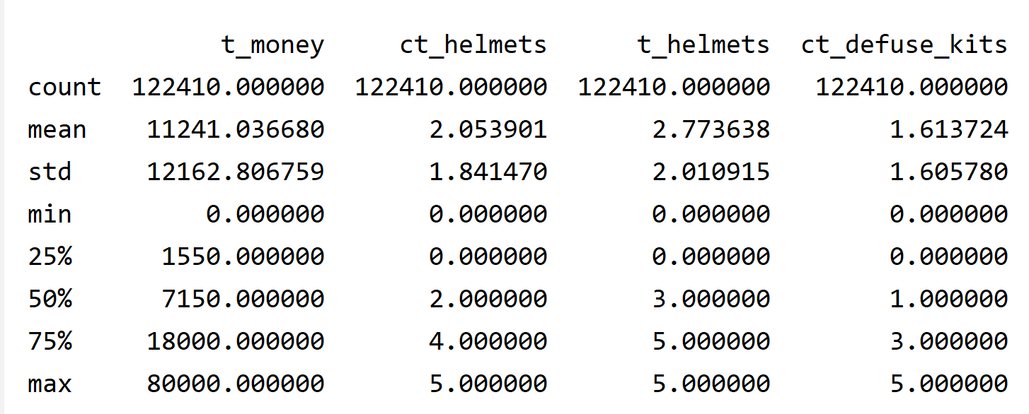
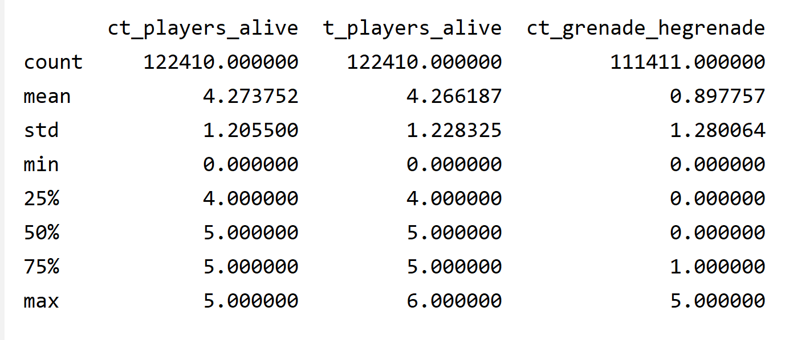
בס"ד
Initial Data Analysis:
Statistics:
26 numerical features :

Slide 7
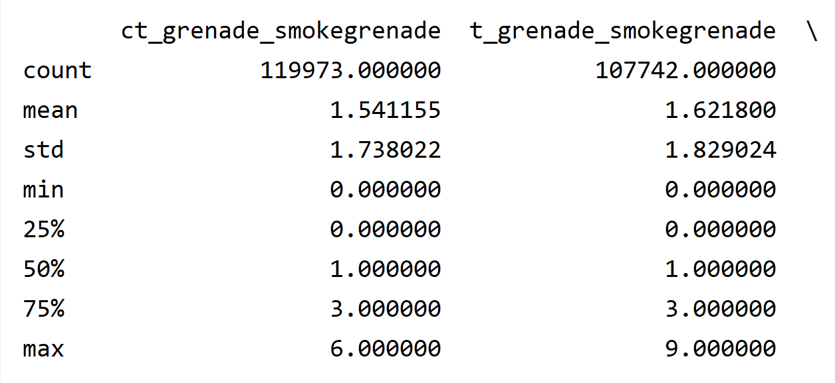
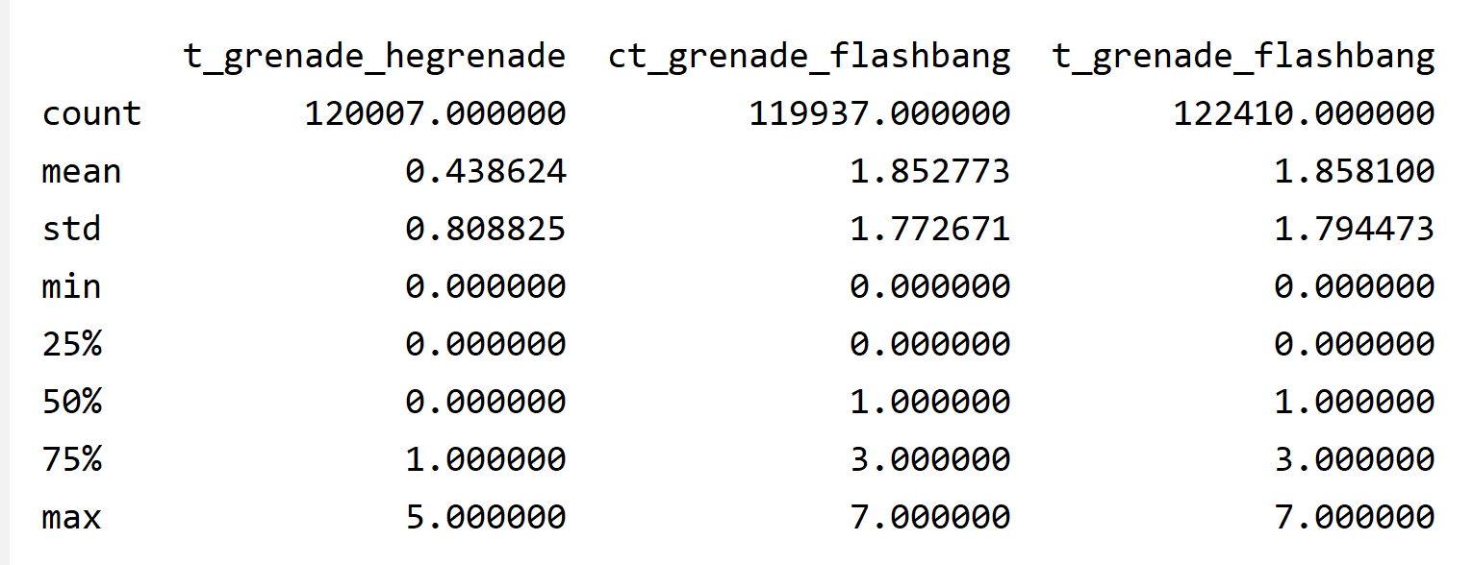
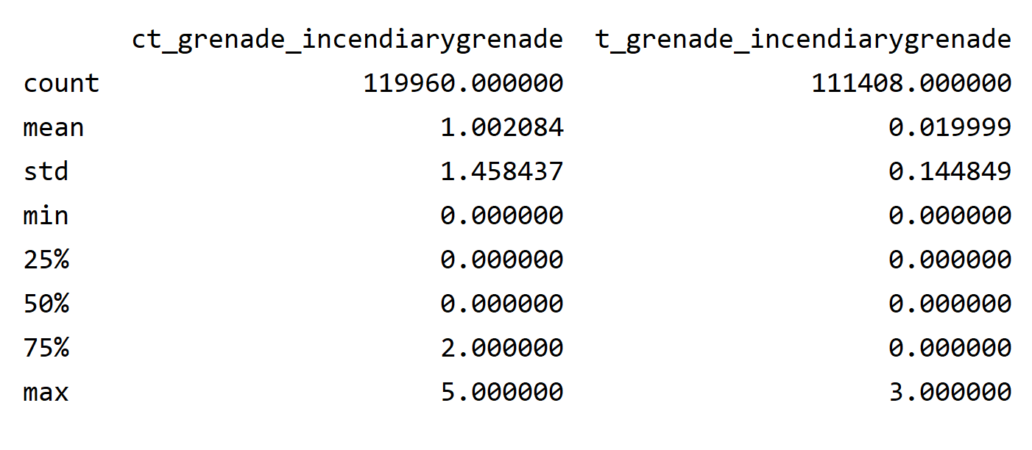
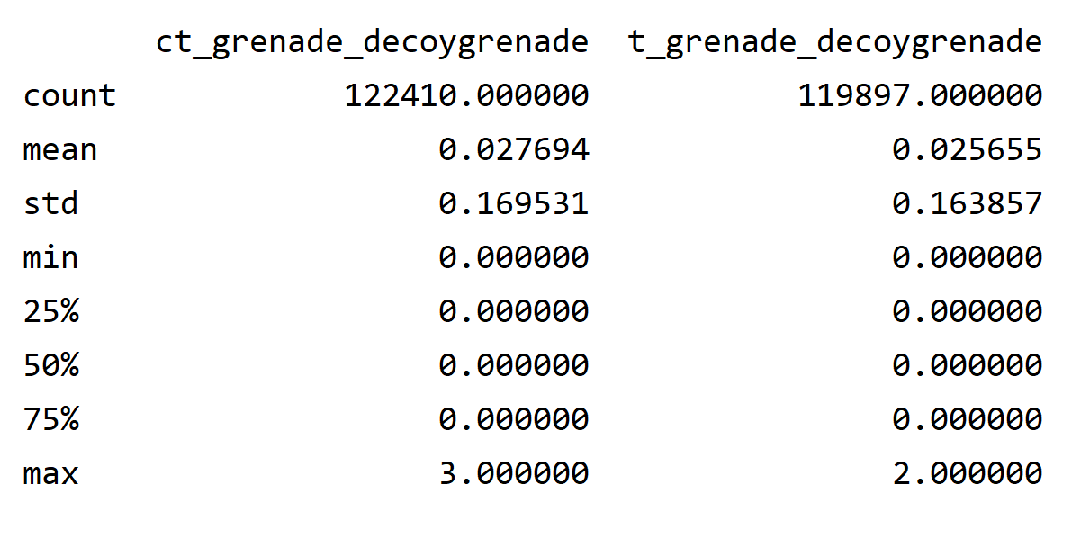
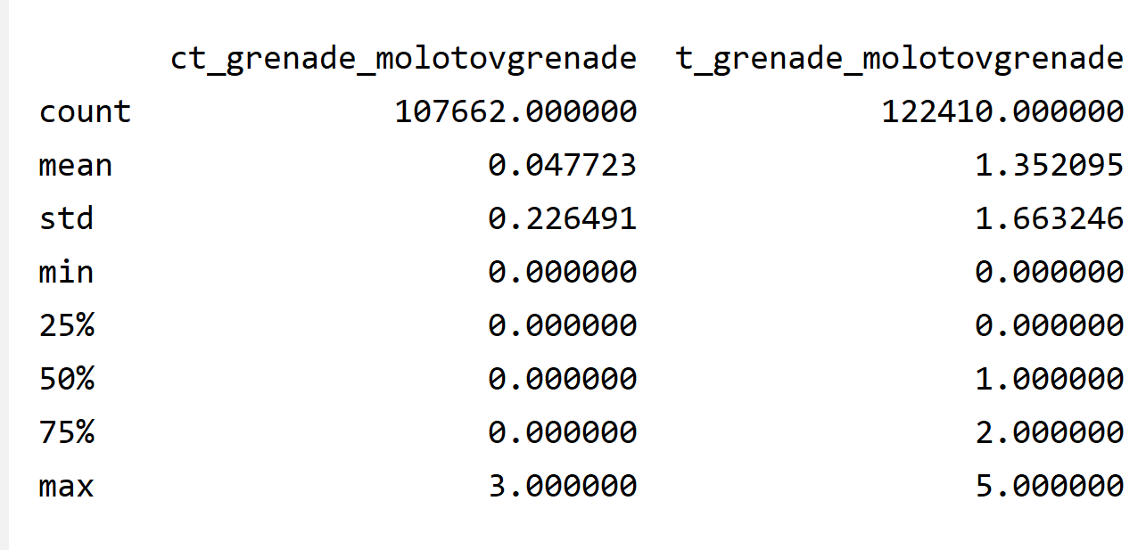
בס"ד
Initial Data Analysis:
Statistics:
26 numerical features :

Slide 8
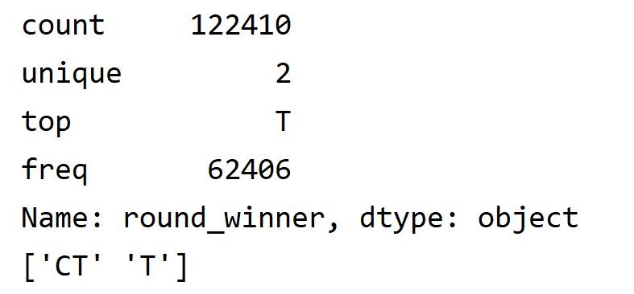
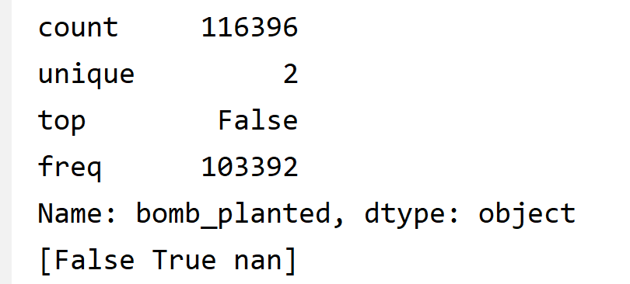
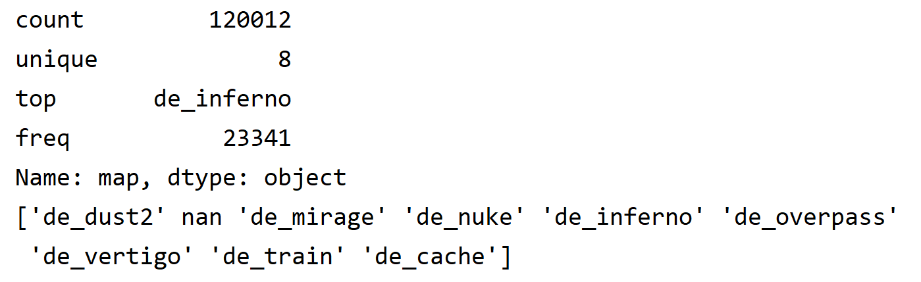
בס"ד
Initial Data Analysis:
Statistics:
3 categorical features :

Slide 9
בס"ד
Initial Data Analysis:
Statistics:
In total 122,410 games in 62406 of them win terrorists ,
and the rest 60004 counter-terrorists.
The average time left is 97.88
The average score as well as average health and average
players alive – are almost the same in both teems .
The money though more terrorist had had
In average terrorists had 35% more helmets to the
team then counter terrorists .
Counter terrorists had 5% more armor (in average).

Slide 10
בס"ד
Initial Data Analysis:
Statistics:
The terrorists used more smokegrenade , and much
more molotovgrenade then counter terrorists (in average).
The counter terrorists used almost twice more
hegrenade, and much more incendiarygrenade then
terrorists (in average).
In most of the games (103,392) – the bomb was
not planted.

Slide 11
בס"ד
Initial Data Analysis:
Summary of data fixes (line 128 in the code):
Some of the features have less then 122,410 filled rows (the
least one is ct_armor that has 100,204 filled rows) –
So I’ve decided to replace the empty fields by putting
Mean value (rounded) in numerical features , and mode
Value in categorical features. (line 23 in the code)
The features ‘t_health’ and ‘ct_health’ that represent the current
heath of the team should be no greater then 500 , but it had some
values that was greater – so I’ve decided to replace whose values
with 500.

Slide 12
בס"ד
Initial Data Analysis:
Summary of data fixes (line 105 in the code):
The features ‘ct_grenade_smokegrenade’ ,
‘t_ grenade_smokegrenade’, ‘t_ grenade_flashbang ‘ ,
’ct_ grenade_flashbang’ and ‘t_ players_alive’ that should not
be greater then 5 , but it had some values that was greater –
so I’ve decided to replace whose values with 5.
I’ve added dummies columns for the ‘round_winner’
And ‘bomb_planted’ feature as : ‘winner_ct’, ‘winner_t’,
’BP_True’ , ‘BP_False’ .

Slide 13
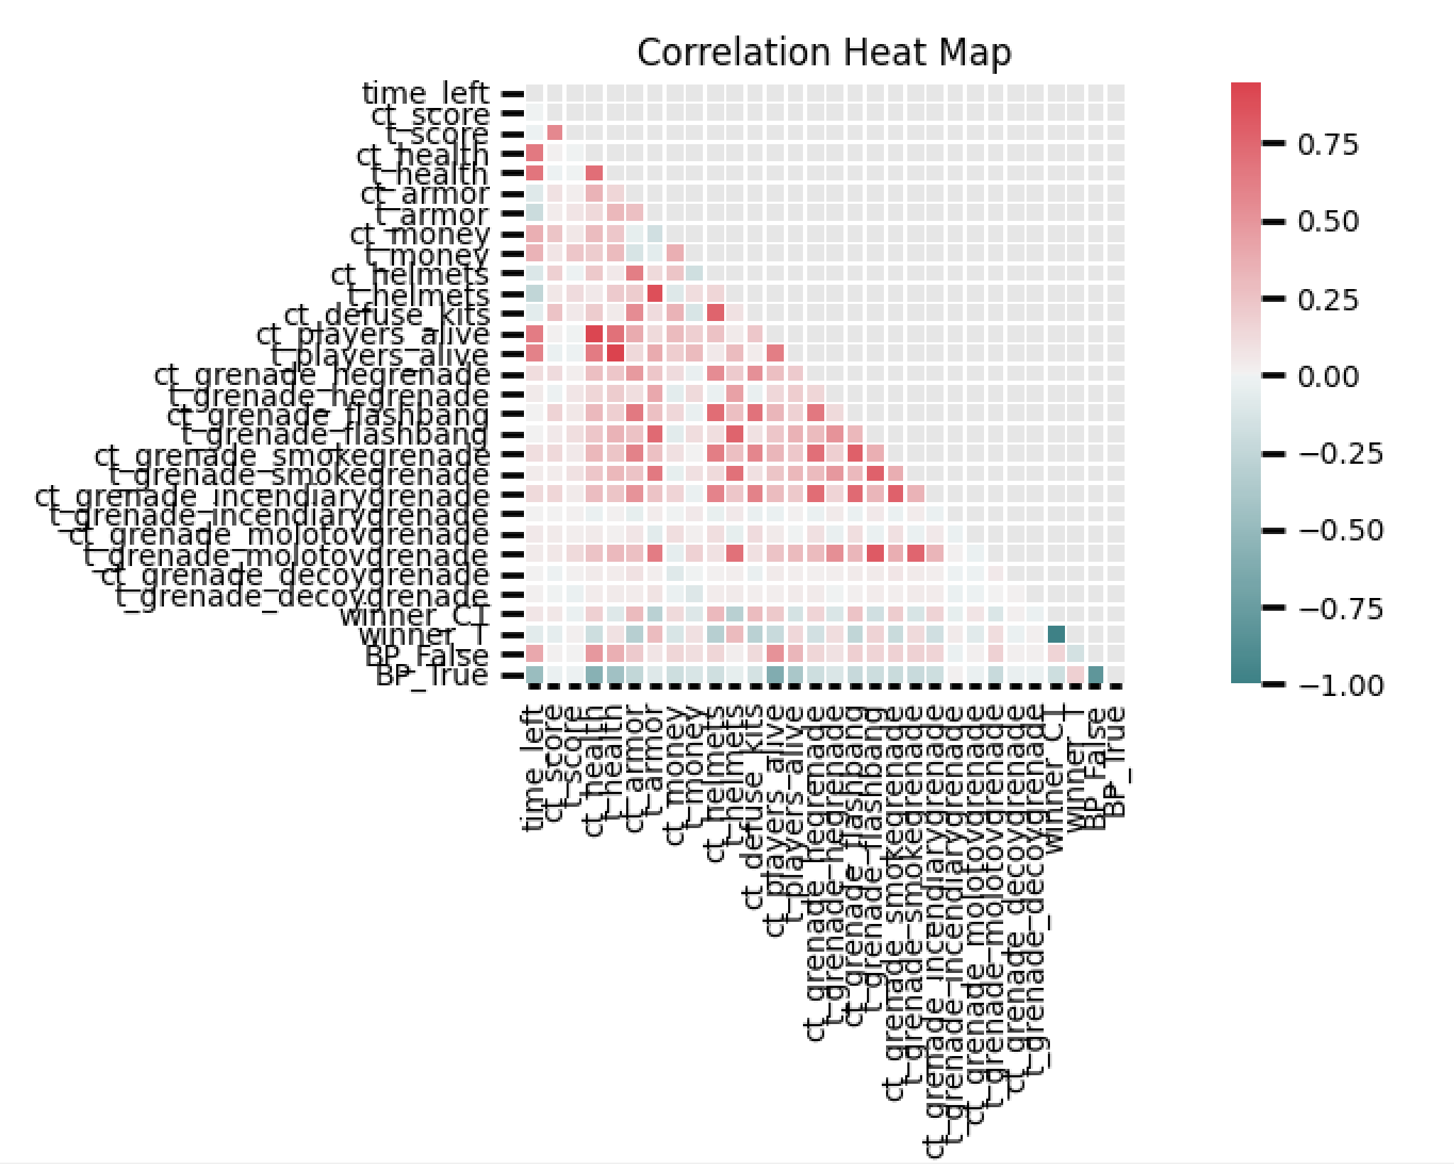
בס"ד
Exploratory Data Analysis (line 126 in the code):

Slide 14
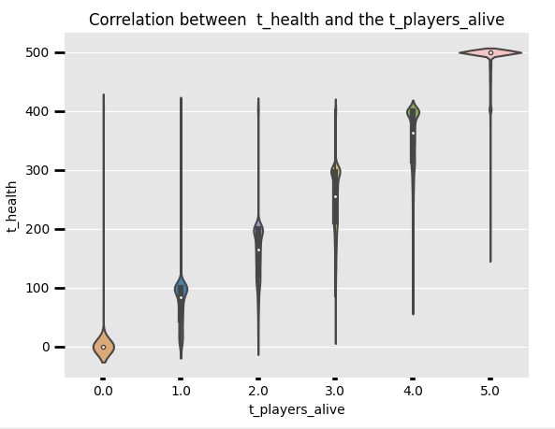
בס"ד
Exploratory Data Analysis (started line 126 in the code):
First of all some obvious correlations:
Between number of players that remained alive and health . Terrorists:

Slide 15
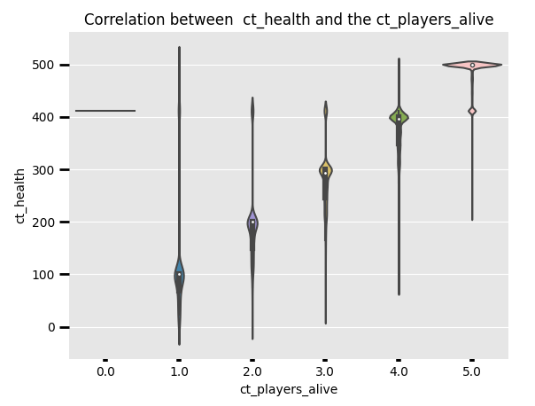
בס"ד
Exploratory Data Analysis (started line 126 in the code):
Between number of players that remained alive and health. Counter terrorists :

Slide 16
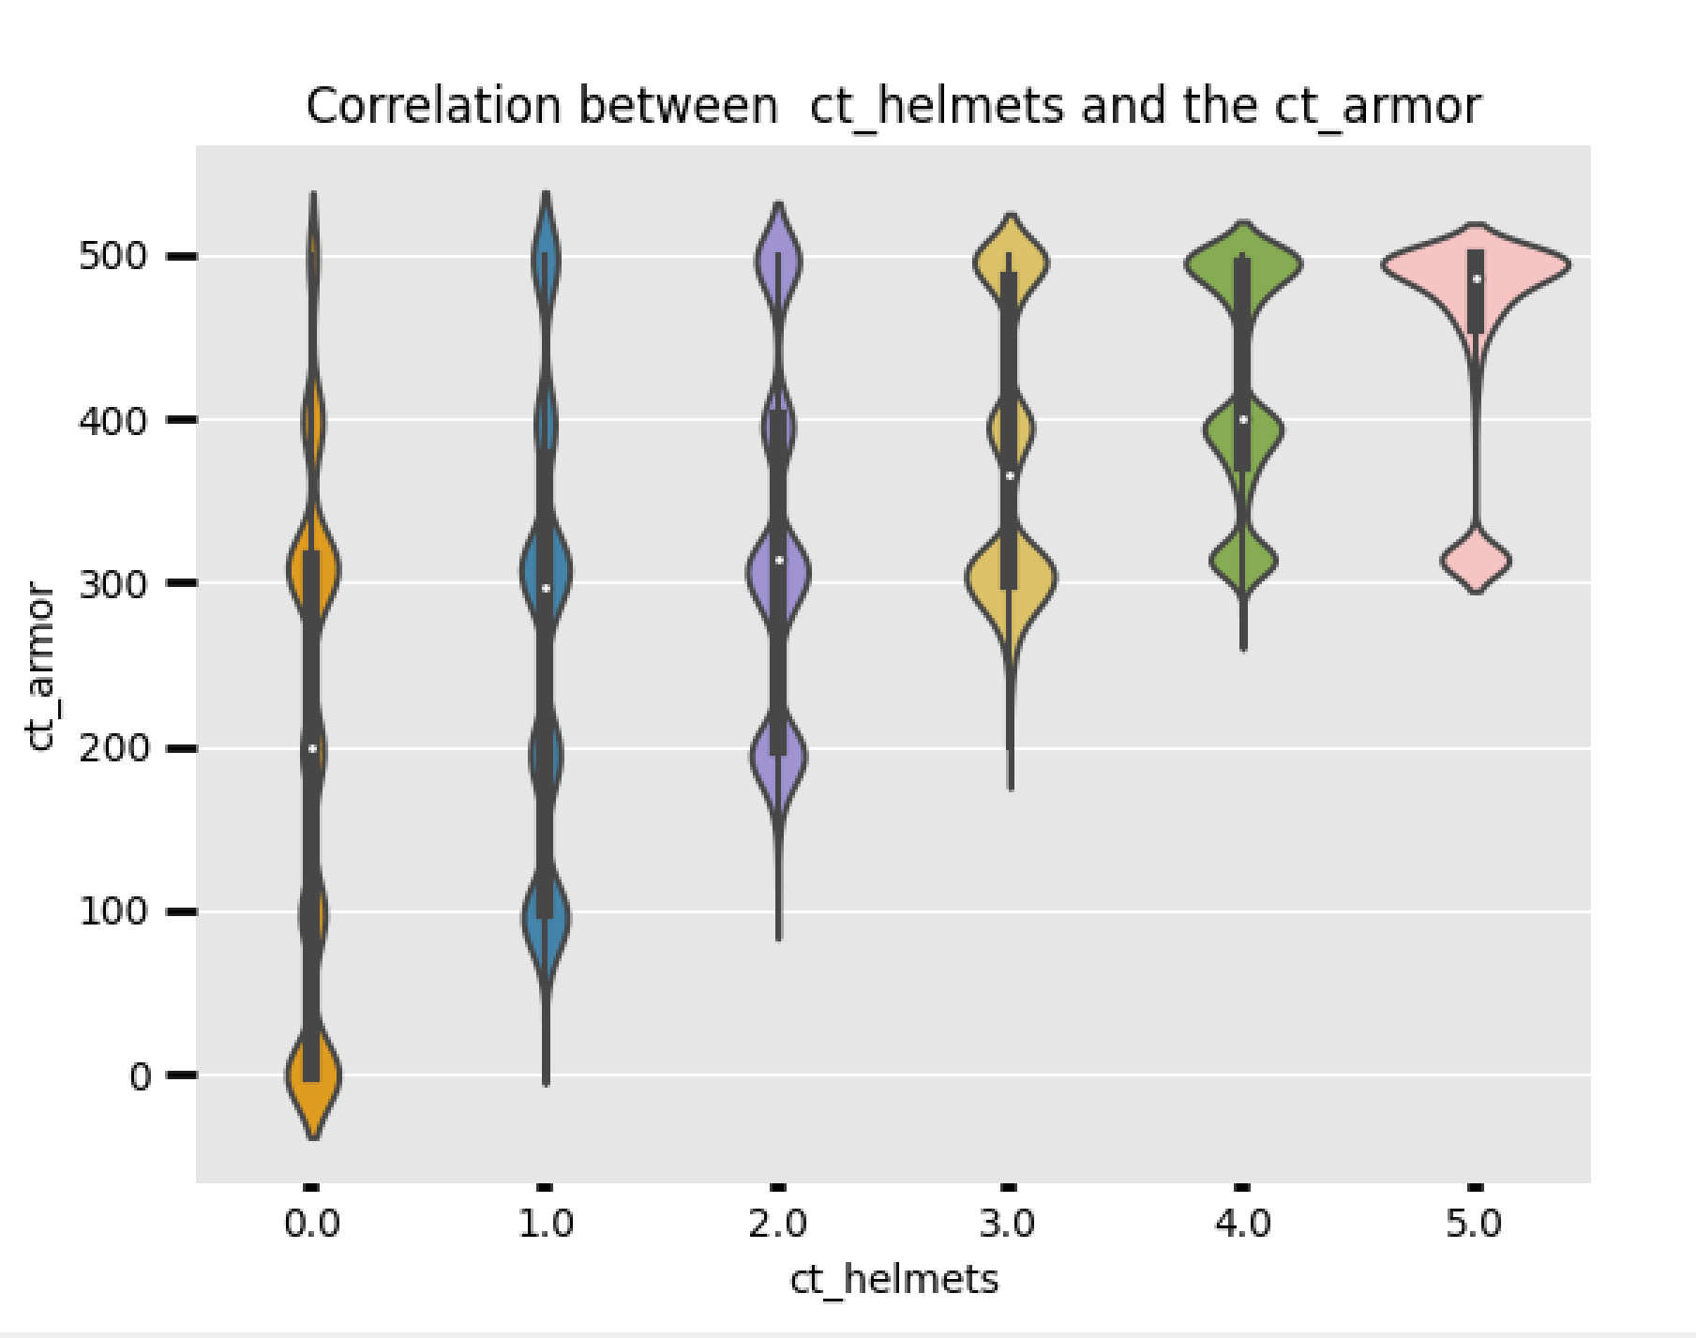
בס"ד
Exploratory Data Analysis (started line 126 in the code):
We can also see some correlation between the number of players with armor and whose who wore helmets.
Counter terrorists :

Slide 17
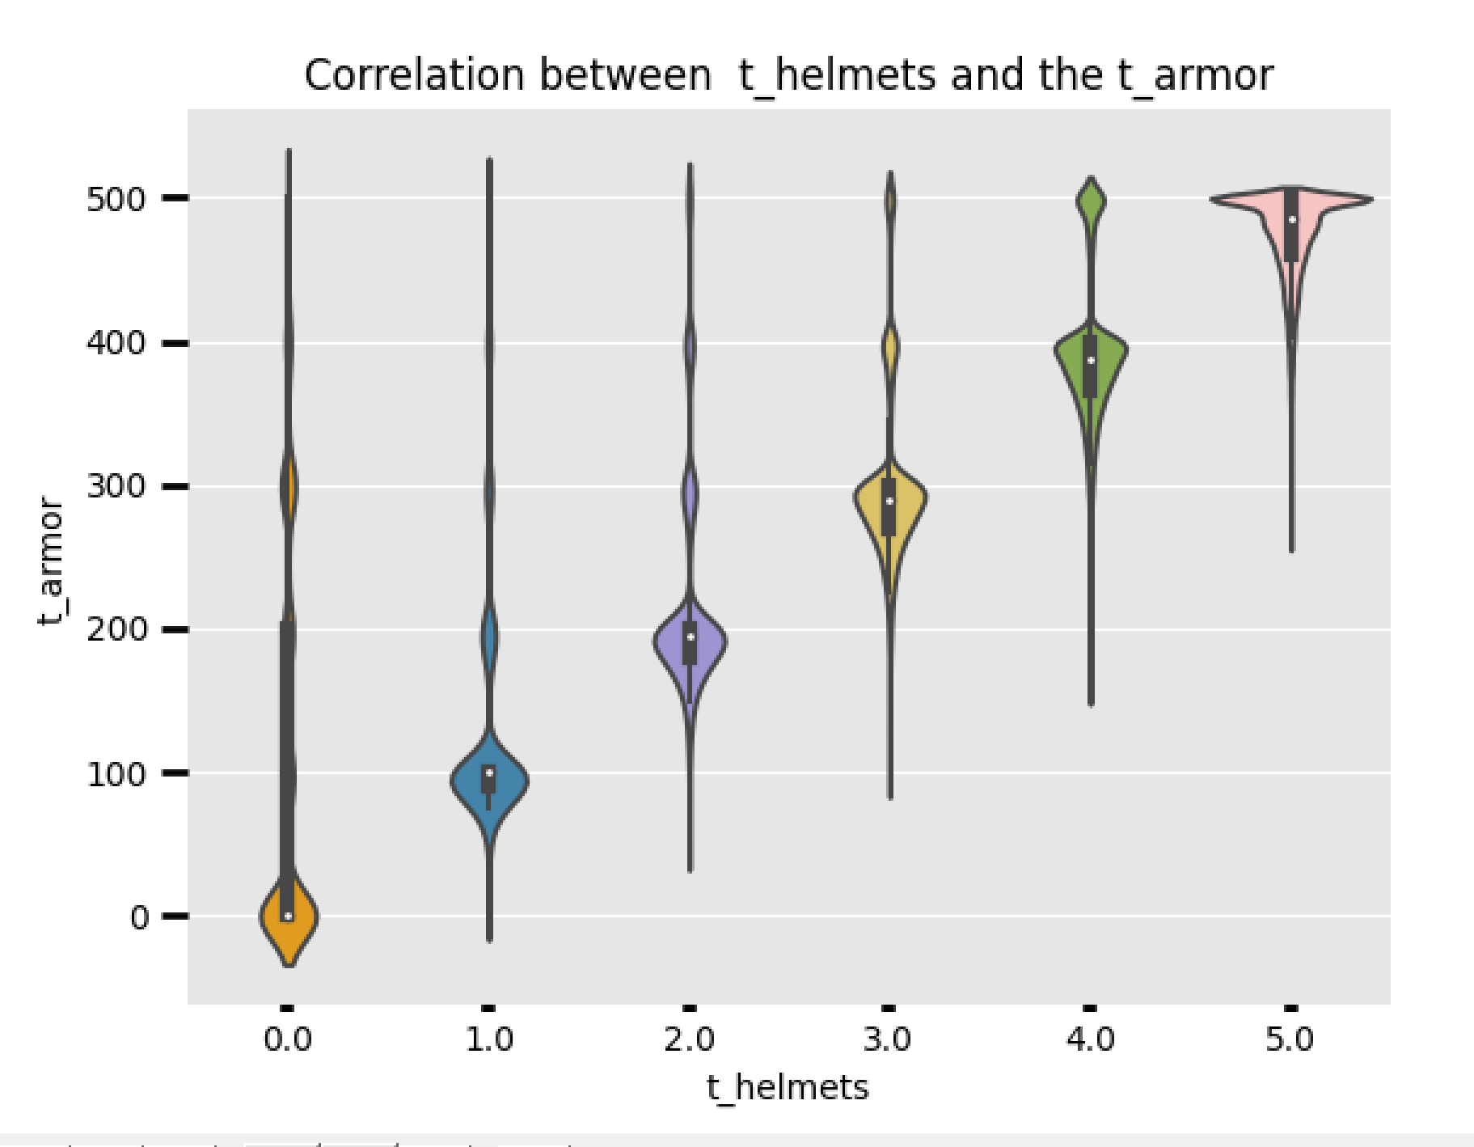
בס"ד
Exploratory Data Analysis (started line 126 in the code):
We can also see some correlation between the number of players with armor and whose who wore helmets.
Terrorists :

Slide 18
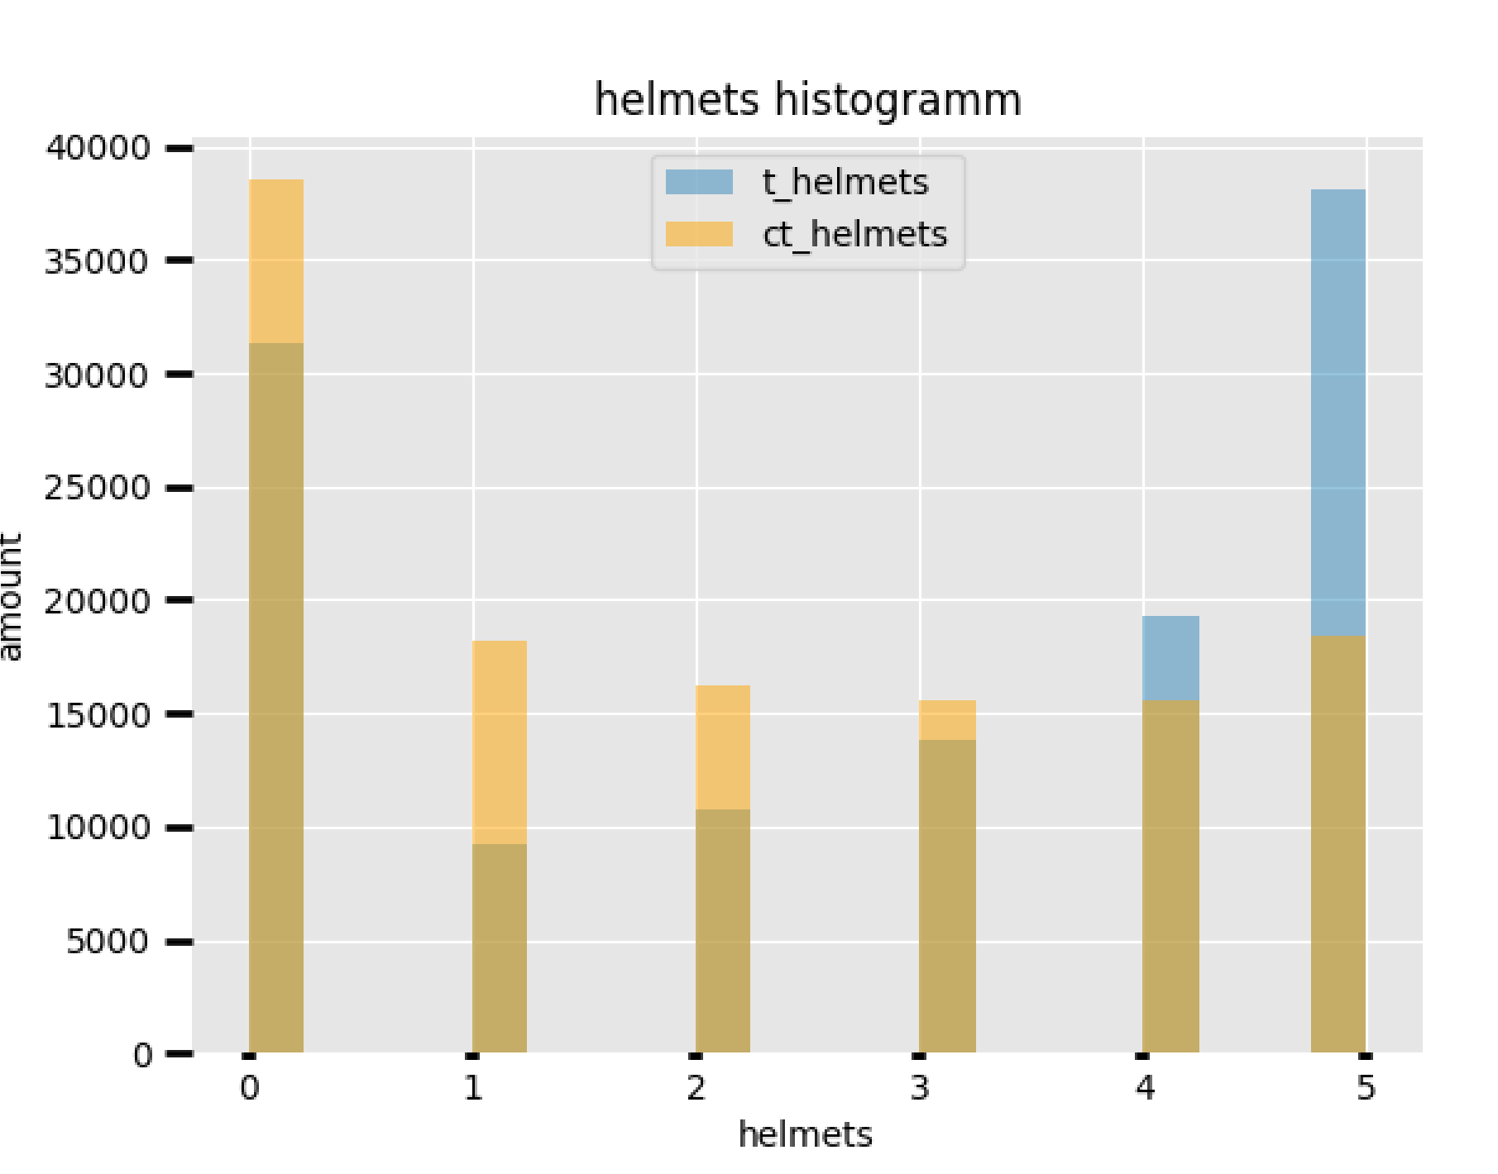
בס"ד
Exploratory Data Analysis (started line 149 in the code):
In the terrorists team most likely all the team wore helmets.
And in counter-terrorists most likely – none of them .(line in code 239)

Slide 19
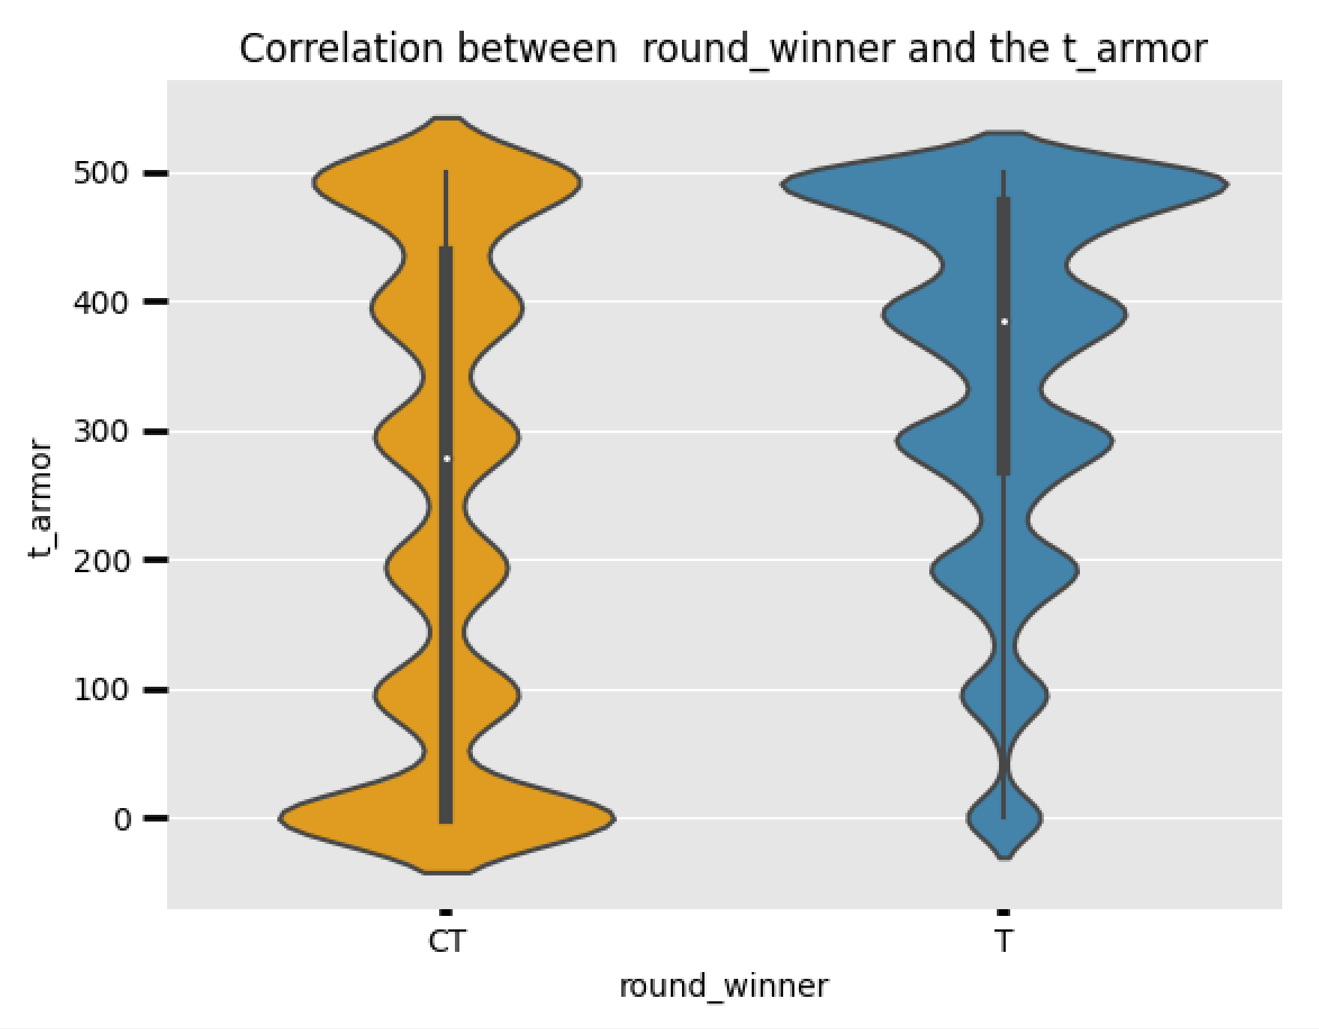
בס"ד
Exploratory Data Analysis (started line 126 in the code):
We can also see the correlation between terrorists amor and who will win the game (line in code - 189):

Slide 20
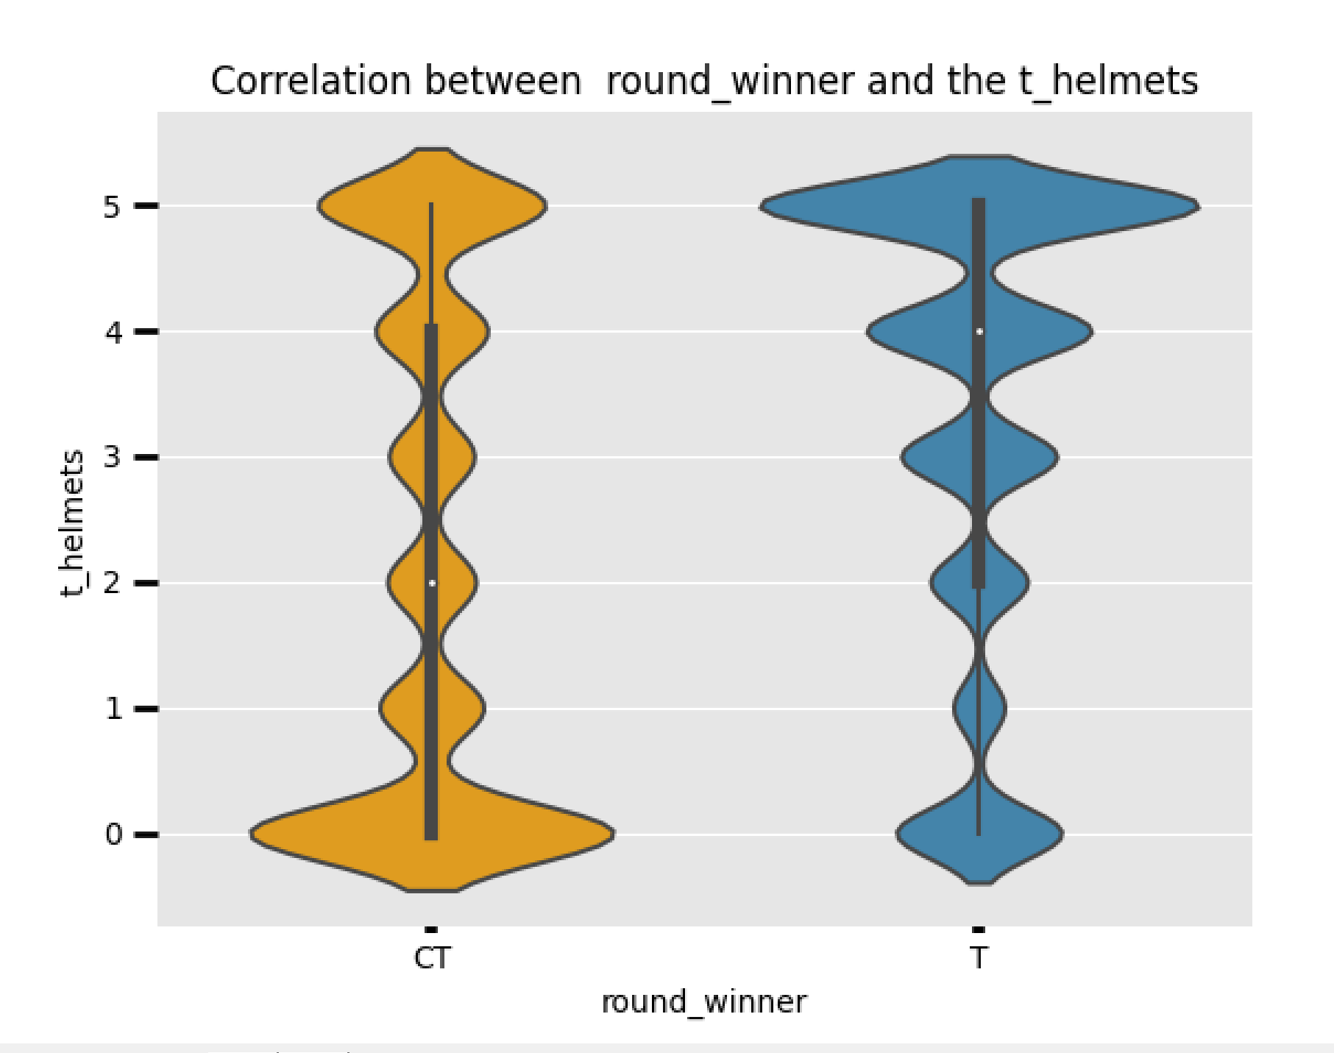
בס"ד
Exploratory Data Analysis (started line 126 in the code):
As well as correlation between the amount of players among the terrorists who wore helmets and the game winner (line In the code - 195) :

Slide 21
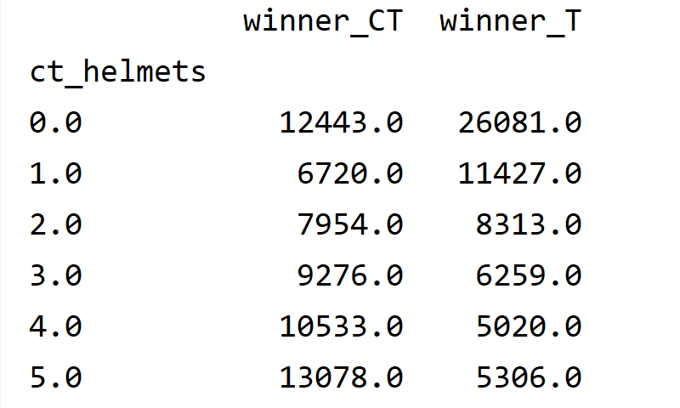
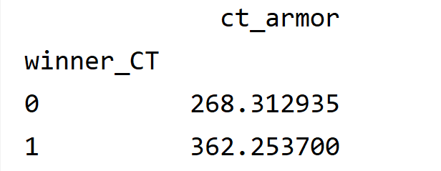
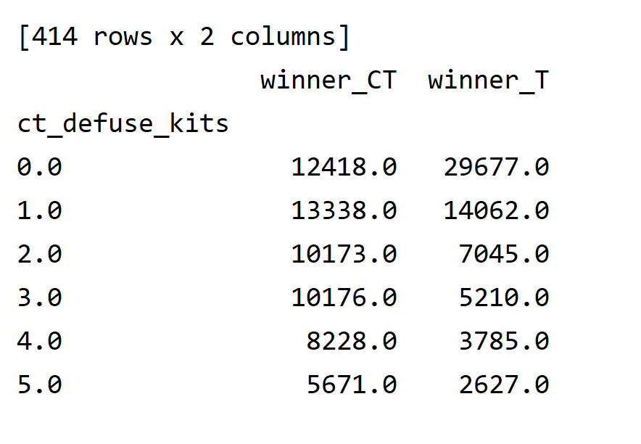
בס"ד
Exploratory Data Analysis (started line 126 in the code):
What about the counter terrorists werring helmets, and have amor ? - There also noticeable correlation
(line In the code - 222) :
Number of defuse kits is also important to the game:

Slide 22
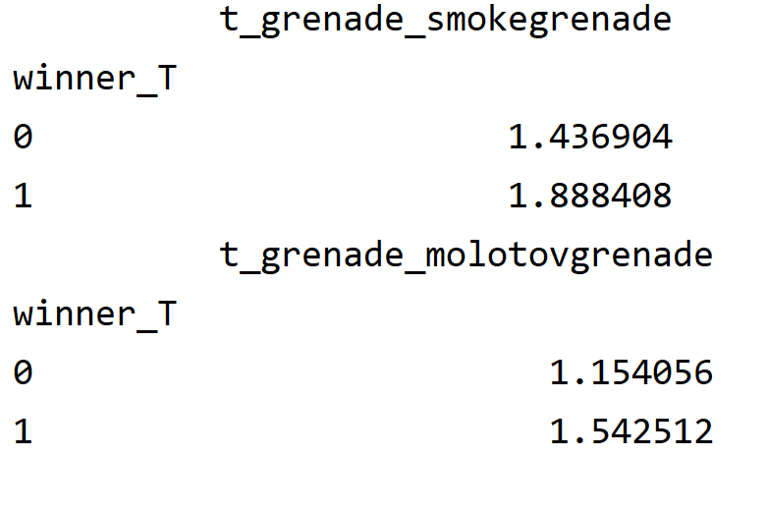
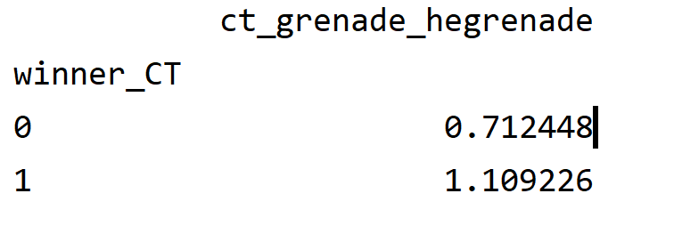
בס"ד
Exploratory Data Analysis (started line 126 in the code):
What about grenate type that players used?
- Some of them are important like :
(line In the code - 228) :
But most of them – not important features .

Slide 23
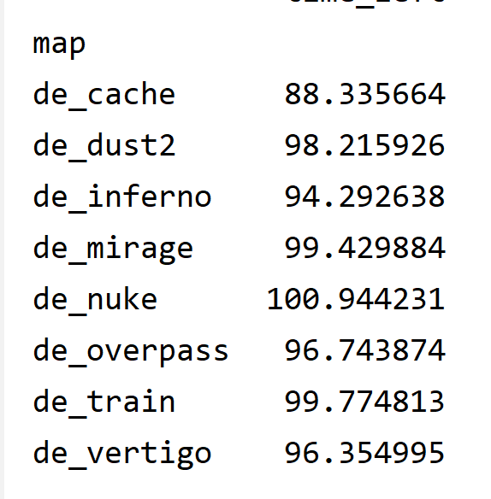
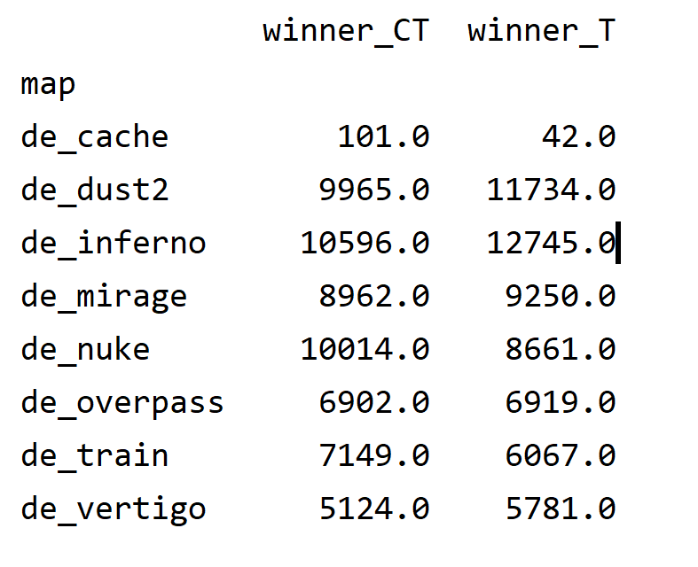
בס"ד
Exploratory Data Analysis (started line 126 in the code):
How about the maps ?
- They played about the same amount of times on each map:
And there is no notisible correlation between the map and the winners:
Except the “de_cache” map , but there is very small amount of game on it.

Slide 24
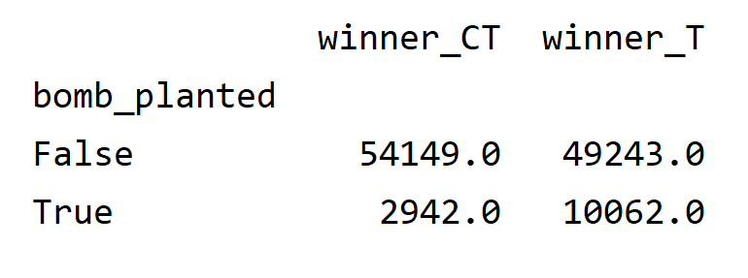
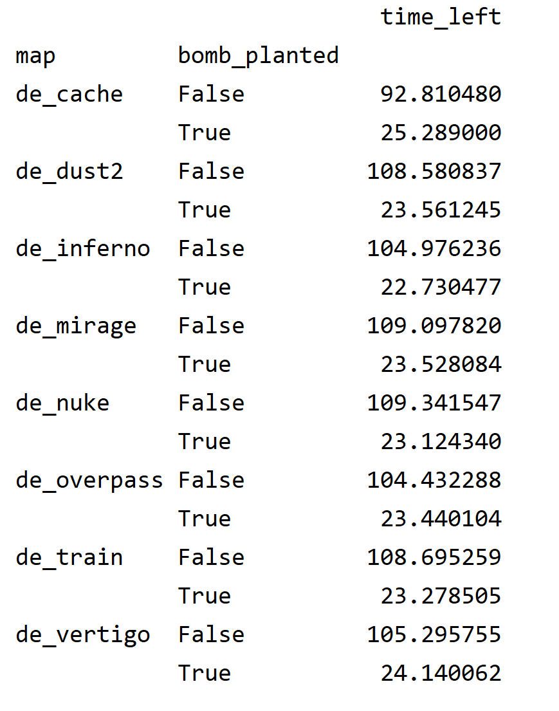
בס"ד
Exploratory Data Analysis (started line 126 in the code):
Amount of bombs that was planted - is important -
We can see that if the terrorists have managed to plant the bomb – most likely they will win the game :
But there is very small amount of times then the
bomb has been planed , and it doesn’t depend
on the map as well –
~20-25 % on eachmap.

Slide 25
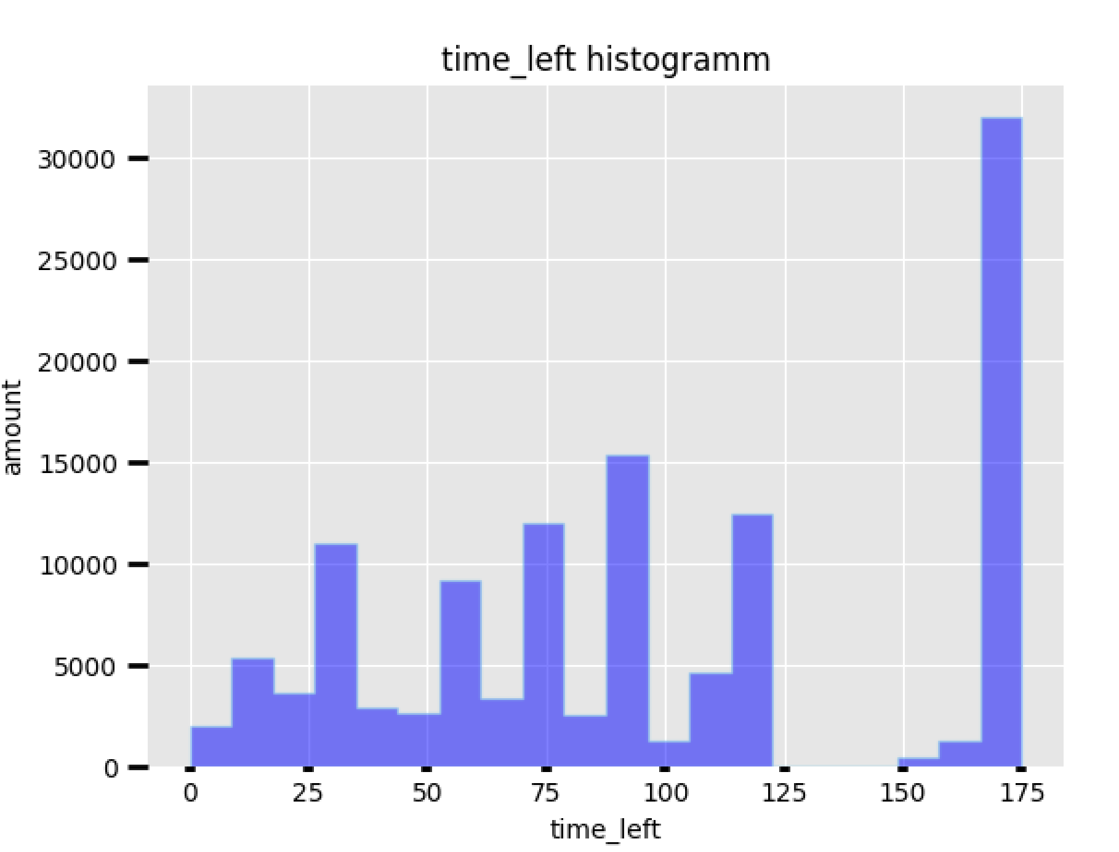
בס"ד
Exploratory Data Analysis (started line 126 in the code):
About the time left - interesting fact -
Most games ended not in the last second , but they have
many time left – actioaly
there are many games
That had around 170 sec
left

Slide 26
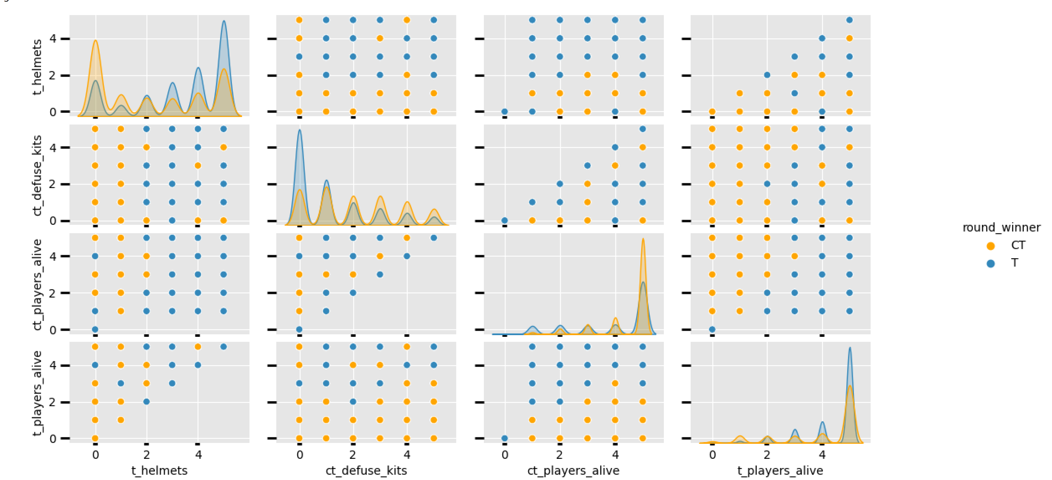
בס"ד
Classification Model(started line 253 in the code):
Lets look on some pair plots – to find the best pair :

Slide 27
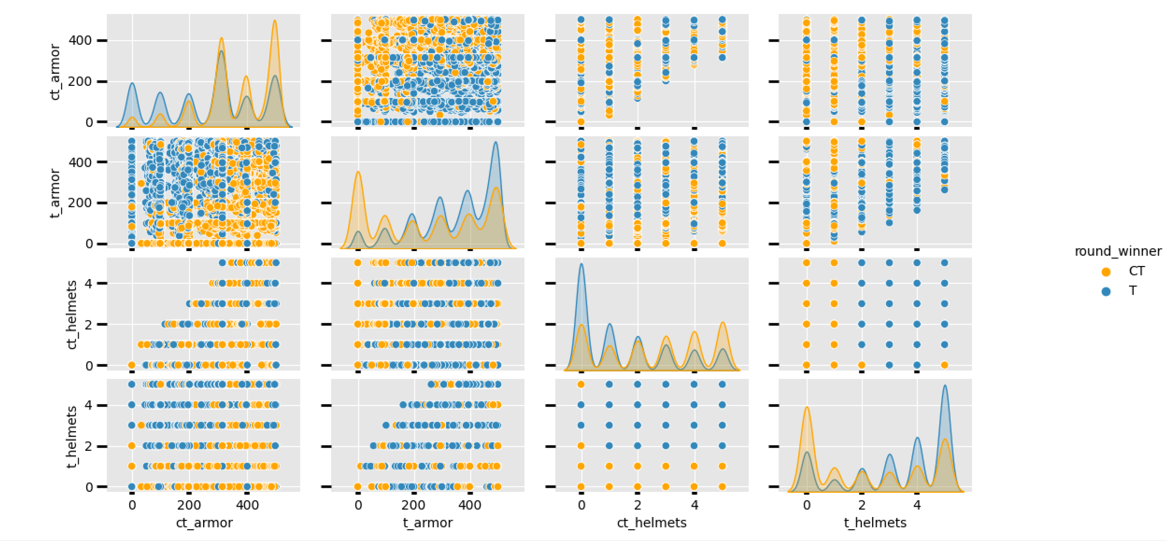
בס"ד
Classification Model(started line 253 in the code):
And some more suspected pairs :
The best looking is t_armor vs ct_armor .
But we”ll check also – t_helmets vs ct_helmets.

Slide 28
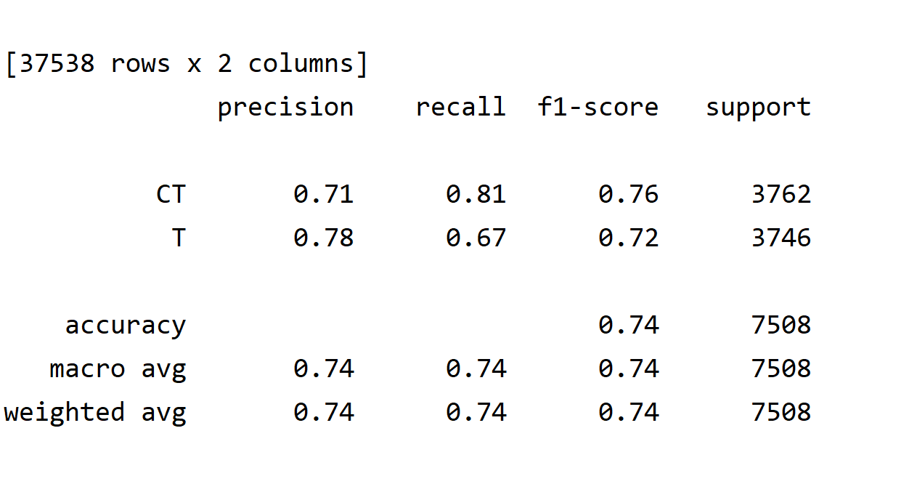
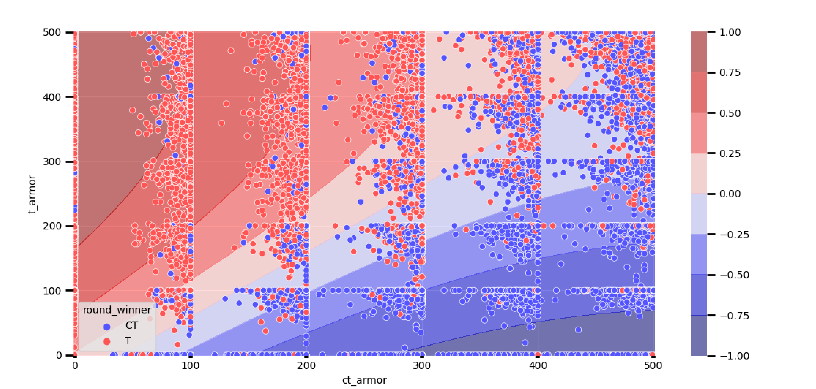
בס"ד
Classification Model(started line 253 in the code):
Gaussian Naïve bayes :

Slide 29
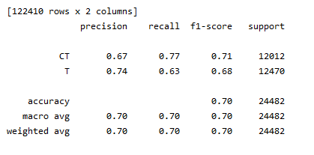
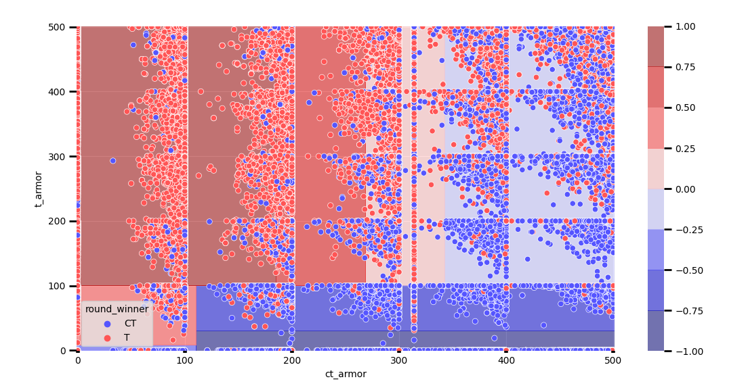
בס"ד
Classification Model(started line 253 in the code):
Decision Tree Classifier
Depth – 3 accuracy 0.70 :

Slide 30
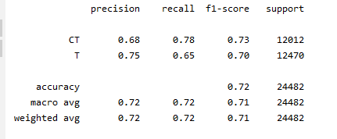
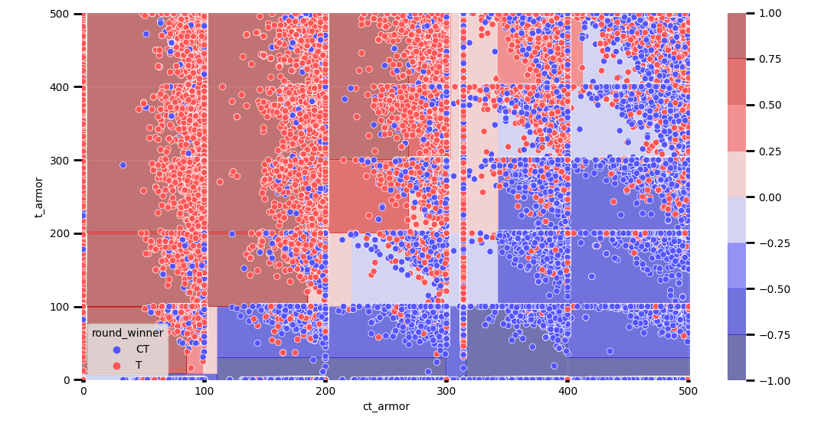
בס"ד
Classification Model(started line 253 in the code):
Decision Tree Classifier
Depth – 5 accuracy 0.72 :

Slide 31
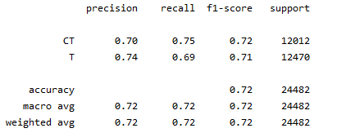
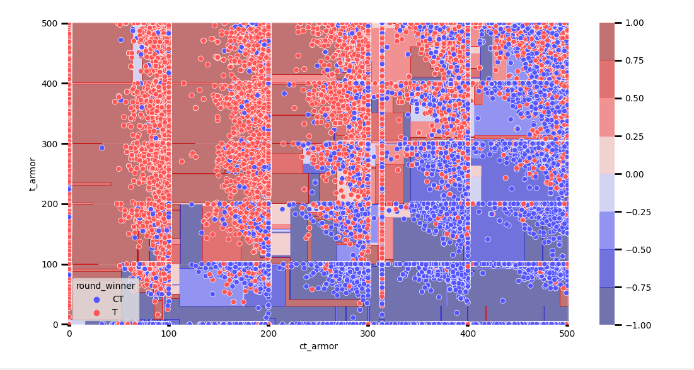
בס"ד
Classification Model(started line 253 in the code):
Decision Tree Classifier
Depth – 10 accuracy 0.72 :
There is no point in doing more then depth 5.

Slide 32
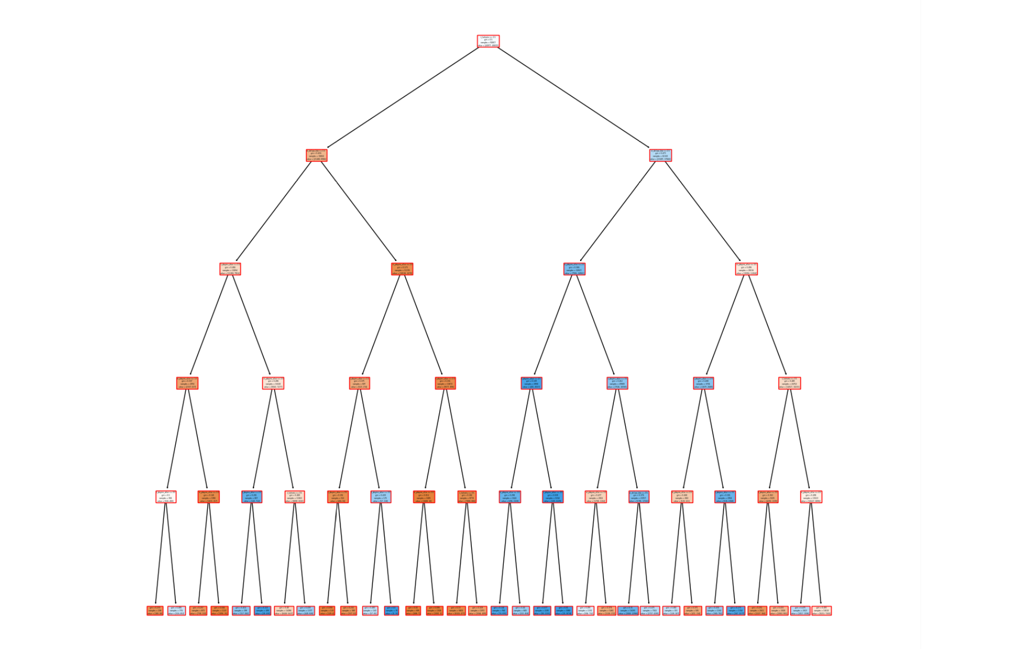
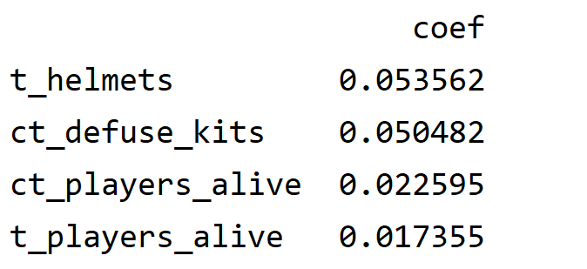
בס"ד
Classification Model(started line 253 in the code):
There is how the tree looks like .
Decision Tree Classifier gini , entropy
(line in the code – 273, 274).
Some other trees didn’t
gave better results :

Slide 33

בס"ד
Summary:
If you decide to play conter strike – it is better to get armor and were helmet -,
and if you play for the terrorists – its better to plant the bomb as soon as possible .

